Slide 1
The New Age Financial Intermediation and Islamic Fintech
Assoc. Prof. Yusuf DINC
Istanbul Zaim University
Case Study:Europe’s first fully-fledged Islamic digital bank!

Slide 2
Content
The new age financial intermediation (NAFI)
Tier I NAFI
Tier II NAFI
Elements
Technology and informatics in banking and financial markets
Performance effect (Literature)
Cost Efficiency
Payment Systems
Cost Reduction
Competition
Expectations/Challenges
Case Study: The first fully-fledged digital Islamic bank of Europe
Insha

Slide 3
The new age banking
The new age banking can be defined as developing financial intermediation process in banking with informatics and computer technologies.
So the new age banking is separated into two layers;
Computer Technologies is the main element of Tier I New Age Banking
Informatics (A.I.) is the key factor for Tier II New Age Banking

Slide 4
Tiers of New Age Banking
Banking is one of the most technology oriented sector in economies.
The whole system can be considered as at least Tier I New Age Banking
So, the total current banking sector is experiencing new age banking since last three decade through computer technologies they employed.
Although in recent years many banks have been engaged in informatics (A.I) through the whole financial intermediation process.
These banks need to be categorized under Tier II New Age Banking

Slide 5
The 4 Elements
The new age banking has 4 aspects;
Accessibility
Cost Advantage
Time Efficiency
Security
Each service has all of these four aspects is part of new age banking activities.

Slide 6
Technology and Informatics in Banking
Technology and informatics offers accessibility and data mining opportunities for banks.
Accessibility is key for marketing and
the technology is the main factor to expand distribution channels.
Even the cyber security problems technology in fact increases security capabilities of banks.
Technology and informatics are keys for credit rationing as well for better allocation of funds. So, they help banking to overhaul the main intermediation function with cost efficiency.

Slide 7
Performance Effect
Technology and performance
Asutay and Harningtyas (2015)
Rusydiana and Sarego (2018)
Waemustafa and Sukri (2015)
Dinc (2017)
Mango et al. (2017)
Salleh et. al. (2017)
Altobishi, et. al. (2018)
Rusydiana and Parisi (2016)
Importance
Positive links
No links

Slide 8
Cost efficiency
The main cost of the financial intermediation is credit intelligence for rationning.
Also increasing accessibility decreases cost for customers.
Cost efficiency has three dimension for both banks and customers;
Success of intermediation
Employment
Time
(For example; card transactions in Turkey is processed in 4 secs that can take minutes in total for both sides if realized in cash.)

Slide 9
Payment Systems
The need for the new age banking is increasing with the increasing addiction in payment systems.
Increasing computer and smart phone literacy is increasing the demand as well.
On the other hand data mining and crating solutions for the customers by the banks is improving both the supply and the demand for new age banking.
Customers appreciate consultancy of banks in that manner.

Slide 10
What else we are expecting?
E-check
Common use of E-cards
E-POS
Common use of Temporary check/card

Slide 11
Cost Reduction
Since the new age banking is cost efficient, its products need to be categorized under cost reducing products.
Although capital need for these services is comparatively low for many mid-scale software developers the new age financial products are under banking monopoly in many economies.
Besides its cost reduction effect banks are charging fees for their new age financial products. Thus they generated income as well.
The most important futuristic advantage of being bank is the opportunity to offer the new age financial services and products.

Slide 12
Web-site/Application
A bank is nothing more than a main banking software and an organizational chart.
The total cost for banking investments for Turkey is more than 100 billion USD.
With the new age banking banks reaches the optimum size in accessibility. Every individual in the World becomes potential customer and access center with a web-site or application.
In the near future, the value of the banks will be calculated based on the number of registered users like social media companies.

Slide 13
Competition
Competition will concentrate on the new age banking products and services
And the trend will follow cost efficiency and alternative distribution channels for the following years in short-term.
In long term with the abolishing of fiat currency, the new age banking will find its new route.
Cashiers and branches will be removed from the system/micro braches or regional large branches may emerge
Physical security cost will be removed and cyber security will be highly demanded
High insurance cost etc. for branches will be removed
Artificial intelligence will hold 70% of the current tasks according to the reports
Personnel expenses will decrease
New competitors will emerge
Credit intelligence products will be demanded by the real sector as well

Slide 14
What else we are expecting?
Optimum transparency in economy
Easy and fast intermediation process
Information «symmetry» problems
Increasing monopoly in real sector
Increasing volume
Decreasing risk base
Increasing share of retail banking
Increasing fund stock
Alternative competitors (non-bank)
Increasing shadow banking share
Crypto banks (stocks): (increasing crypto literacy (what causes?))

Slide 15
Case Study
Insha: The First European Digital Islamic Bank
Many would be quick to assert that Islamic digital banks would be the answer to raising financial inclusion of global Muslims, but very few have translated the concept of a fully-fledged digital bank into reality in the Islamic space.
An AlBaraka Turk initiative, the digital bank has been built on Berlin’s SolarisBank’s open banking platform and it is Europe’s first digital-only bank offering customers in Germany Shariah compliant services such as debit card, banking account, and money transfer to nations in the Single Euro Payments Area and Turkey.

Slide 16
Case Study
The platform is supported by a multilingual call center.
The platform is showcasing promising traction: within two months of launching, the app has been downloaded over 9,000 times. And while it is currently only available in Germany, Insha is already working on opening its interest-free services to seven other European countries next year, with hopes of growing its customer base to 20,000 by the end of 2019.

Slide 17
Market
There are also plans to expand its product suite to include business banking instruments.
Home to some 20 million Muslims, the European retail Islamic banking market has been tough to penetrate due to the fragmented concentration of Muslims across the region which has rendered the establishment of a brick and mortar Islamic retail bank unfeasible.

Slide 18
Strength
Insha represents an opportunity to overcome the issue of a lack of sizeable customer base due to geography and bring Shariah compliant banking services to Europe’s growing Muslim population.

Slide 19
Infrastructure
Succeeding where many have failed, Insha has managed to roll out its services at a relatively low cost and shorter time period through its collaboration with SolarisBank.
The bank-to-bank cooperation – said to be the first in the area of digital banking – saved the start-up approximately EUR4.5 million (US$5.13 million) and shortened its time-to-market by more than half.
A German banking license would require EUR5 million (US$5.7 million) in capital and the process would have taken between 12-24 months; Insha sidestepped these hurdles by leveraging on SolarisBank’s banking license and API, paying only a setup fee to the Berlin bank. It took less than a year for the team to build its platform and within six months, Insha accepted its first customer.

Slide 20
Islamic Banking in Europe
While it remains to be seen if the young Insha could attract 20,000 customers next year as targeted, as the first Islamic challenger bank in the region, its emergence could be instrumental in driving financial inclusion for Muslims in Europe, whose banking needs are sorely underserved: there are only six fully-fledged Shariah banks in the UK (most serving the business and corporate markets) and one in Germany, while efforts to launch an Islamic bank out of Luxembourg have struggled to take off.

Slide 21
Multi-Country
The start-up is working on penetrating France, the Netherlands, Belgium, Austria, Poland, Italy and Spain over the next 12 months – all markets with little to no Islamic financial activities. If successful, it could spur a new wave of development for Shariah compliant finance in new European markets.

Slide 23
INDEPENDENT
The customers can open an account without going to the branch and card comes to the feet
FAST
Without paper, contracts, forms, signatures, and pens. Transactions does not steal customers’ precious time, everything processes very quickly

Slide 24
CONTROL
The customers can check everything they have on their account, their card, and have the control completely ...
RELIABLE
Reliable, robust infrastructure and serving in native language
ISLAMIC BANKING
Making no concessions to the principles of participation banking

Slide 25
FRIENDLY
To express participation banking with sincerity, to calculate the zakat, to find out where the nearest mosque is
GUIDE
Directing people on money saving and spending, talking to them about their transactions

Slide 26
LEAN
Customers do not be lost between complex and numerous menus, interfaces
ONE OF US
Close enough to go to Friday prayer together, friendly, non-marginalizing

Slide 27
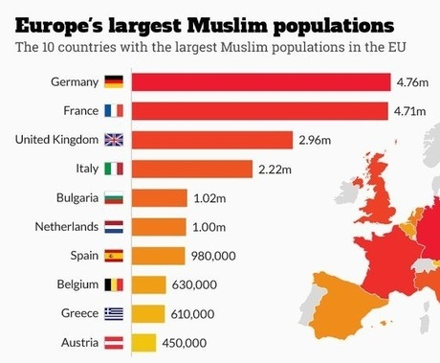
Muslim population in Europe
20
^{m}
There are 20 million Muslim population.
8
^{m}
The number of settled Turks is 8 Million.

Slide 28
The proportion of the Muslim population to the total population will increase and Muslims will have a greater economic strength.
In the last 10 years, the Muslim population has grown from 4% to 6.2% of the total European population.
14%
Expected Muslim population in Europe in 2050
Resource: PEW Research & ArabNews

Slide 29
They are showing specific consumption behaviors and are not satisfied with the current banking experience.
The Muslim youth expect the financial services sector to adopt not only Money management, but also social responsibility.
Generation M
Resource: PEW Research & ArabNews

Slide 30
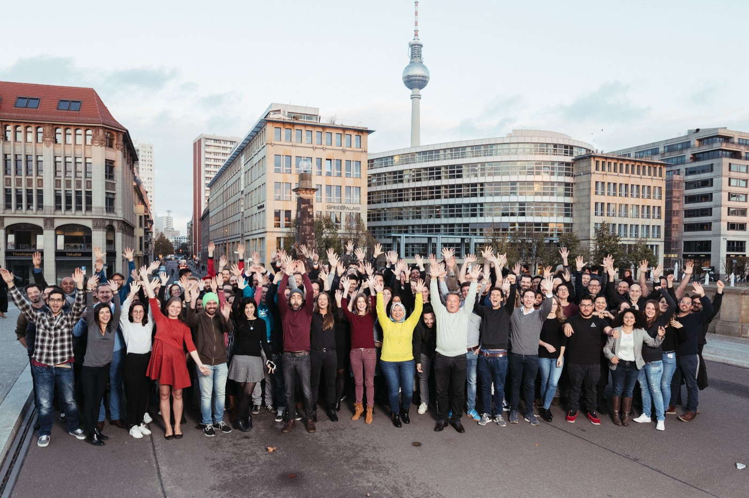
BAAS (Banking as a service) Model
It is the business models in which enterprises develop their own brands by taking the infrastructure services from other service providers.
SolarisBank offers the opportunity to do banking with your own brand in Europe using its banking license and infrastructure.
First BAAS Bank in Europe.
Established in March 2016
Banking Passport for 7 Countries
120 Employees and Strong Investors

Slide 31
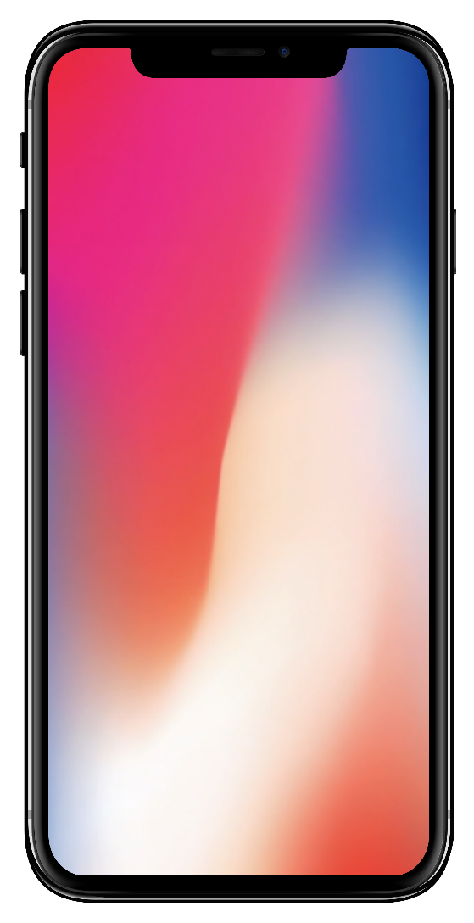
Open a Shariah-compliant bank account only in 8 min.

Slide 32
Mobile App

Slide 33
Mobile App

Slide 34
Debit Card
Stylish and vertical debit card.
Leading a new pure desing trend.

Slide 35
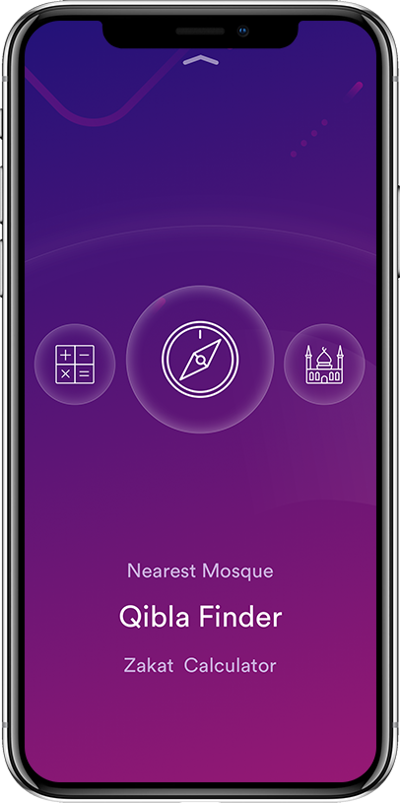
A Friendly Asistant to the Muslims
Mosque
Map
Zakat
Calculation
Prayer
Reminder
And
More…

Slide 36
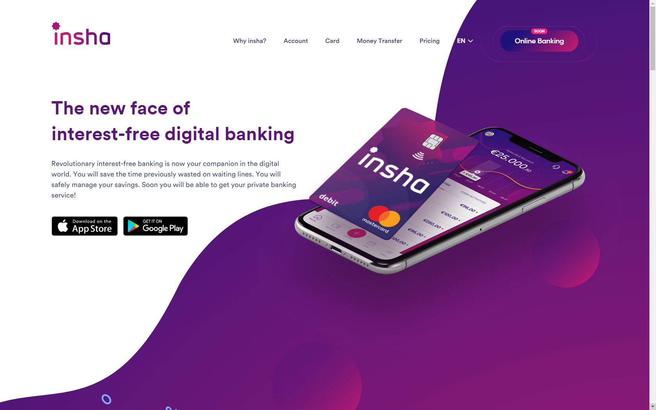
Website and Online Branch
An informative content in three languages and fresh design!

Slide 37
Call Center
Call Center service is available in Turkish, German and English.

Slide 38
Money transfer
From Germany to Turkey - money transfer mechanism will work 7/24.

Slide 39
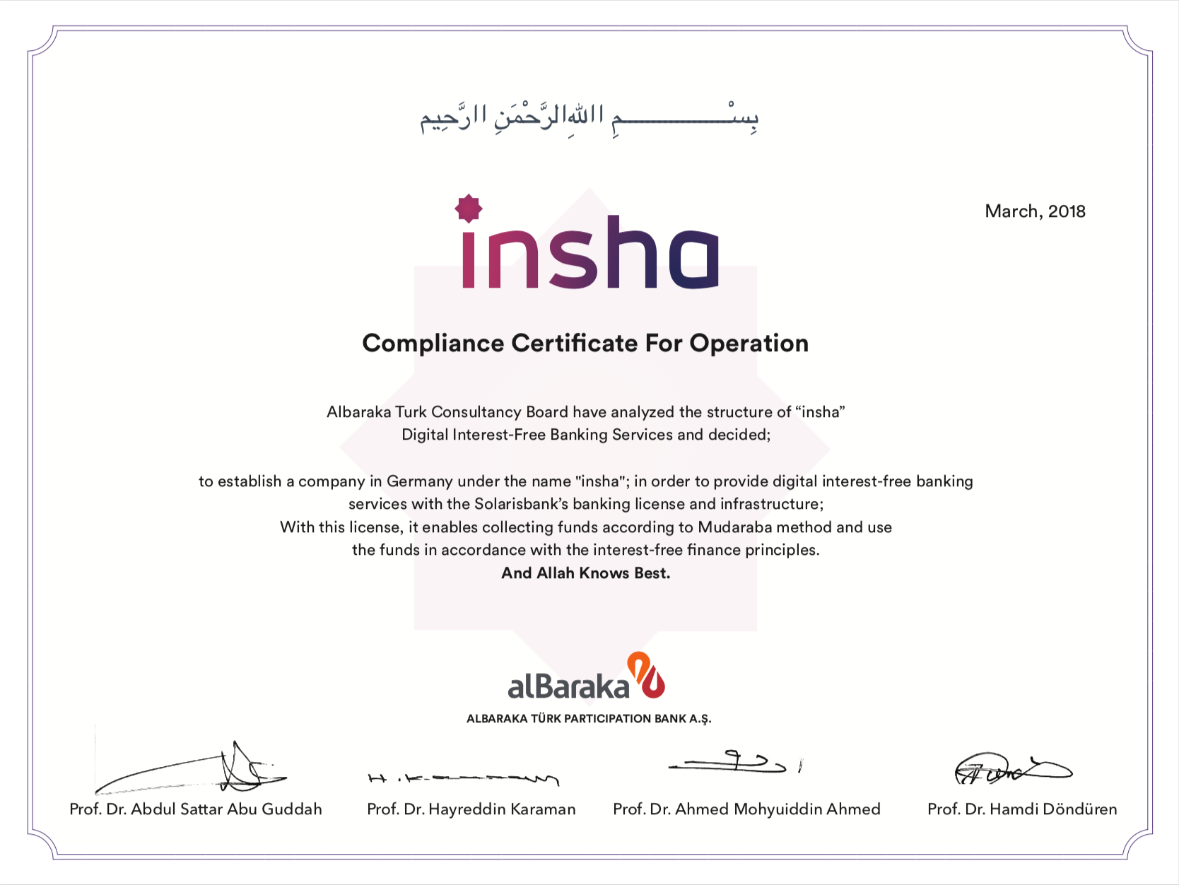
Fatwa

Slide 40
Service Area
Germany
France
Austria
Spain
Belgium
Poland
Netherlands
MVP Phase
Growth
Scale Up

Slide 41
Operation
Core team based in Berlin.
Support team based in Istanbul.

Slide 42
Expansion Strategy
04
Phase
Banking License in Europe
03
Phase
Insurance and Investment Products
02
Phase
Participation Accounts, Retail Financing
01
Phase
Accounts, Money Transfer, Debit Card

Slide 43
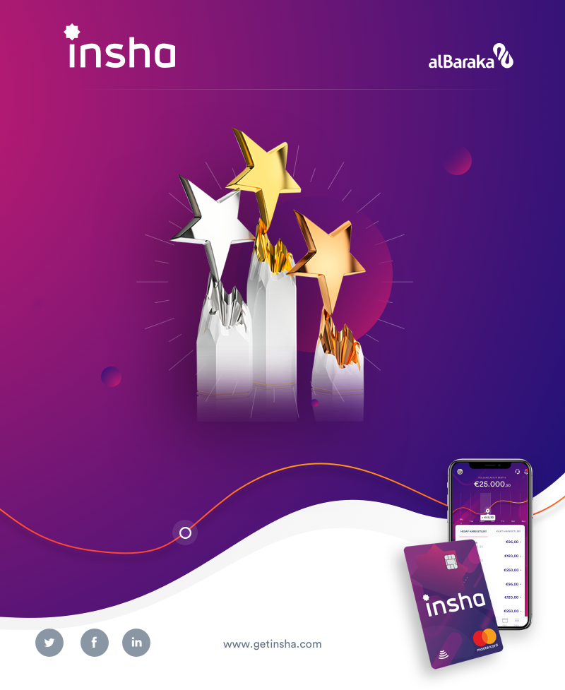
Critic’s Choice Best Digital Banking Initiative 2018
Islamic Retail Banking Awards 2018

Slide 44
Thanks
Q&A

